Slide 1

Real-Time Predictions
H₂O.ai
H2O // Storm
Spencer Aiello
spencer@h2o.ai
Jan 15, 2015

Slide 2


H₂O.ai
Overview:
Introductions
Real Time Analytics
The Speed of Information
The Analytics Workflow
H2O // Storm
Demo

Slide 3
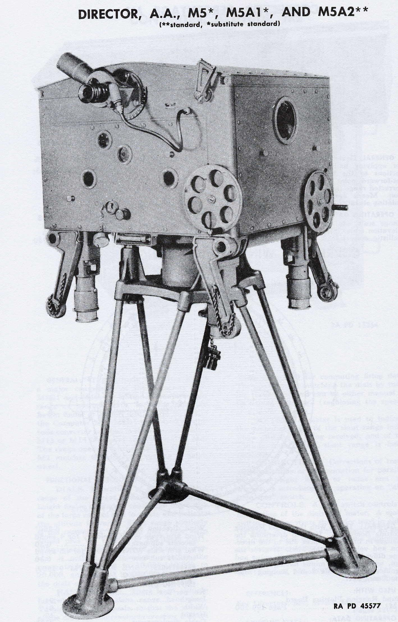

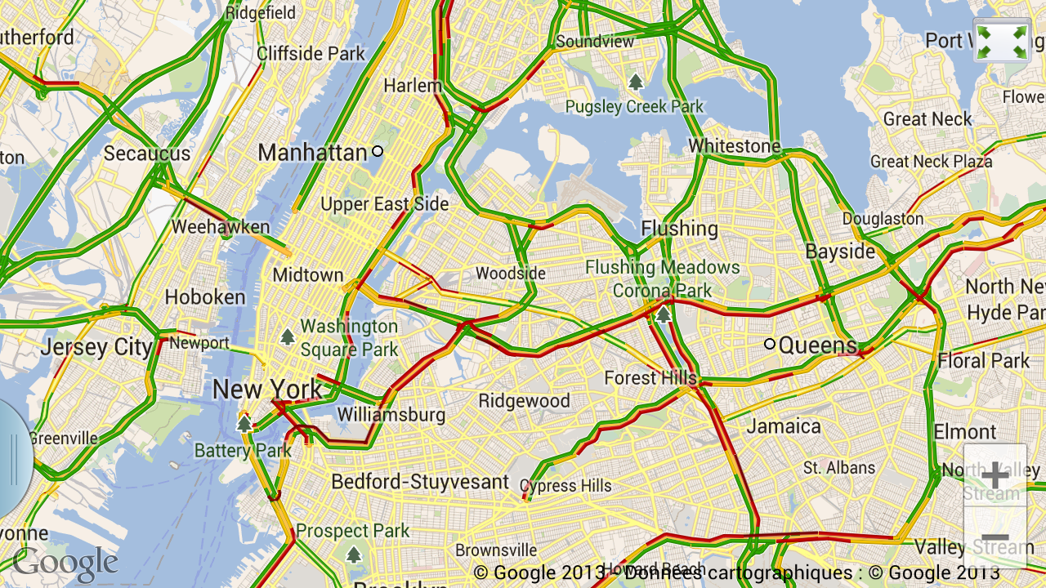
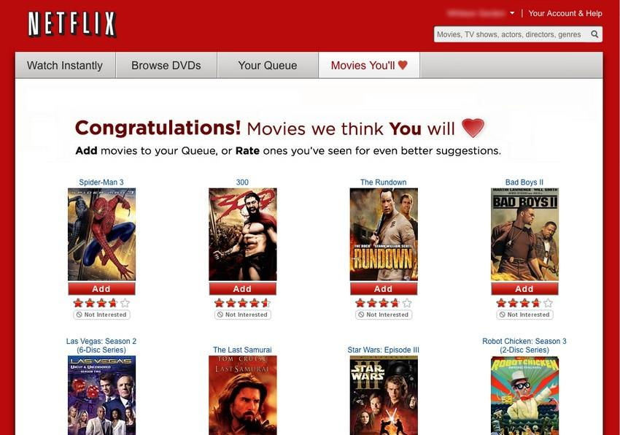

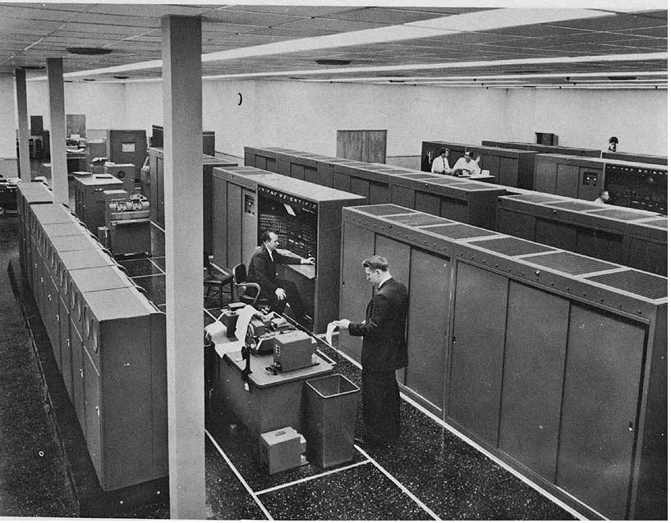

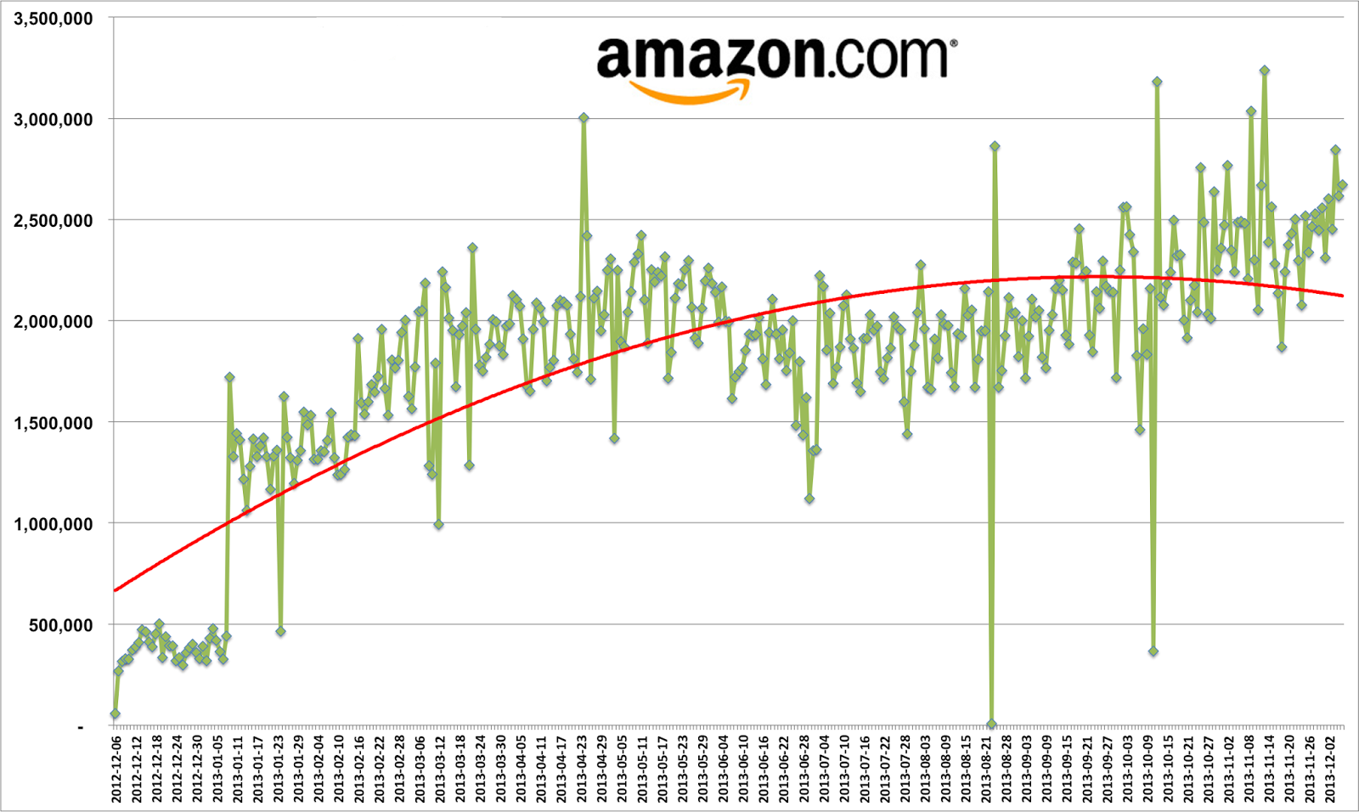
Real Time Analytics: Then & Now
H₂O.ai
Real Time Roulette Wheel Prediction With A Computer In A Shoe
Kerrison Predictor
Traffic Management
1930 - 1940s
1970s
1950s
1990s
Real Time Analytics to Fight Fraud
ENIAC - Weather Modeling (pseudo real time)
Shopping & Movie Recommendations
Dynamic Pricing

Slide 4
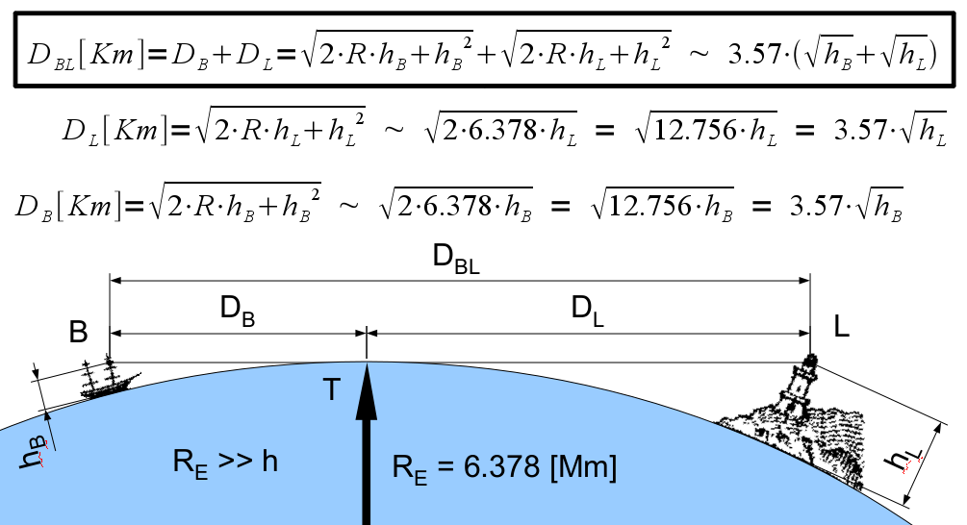
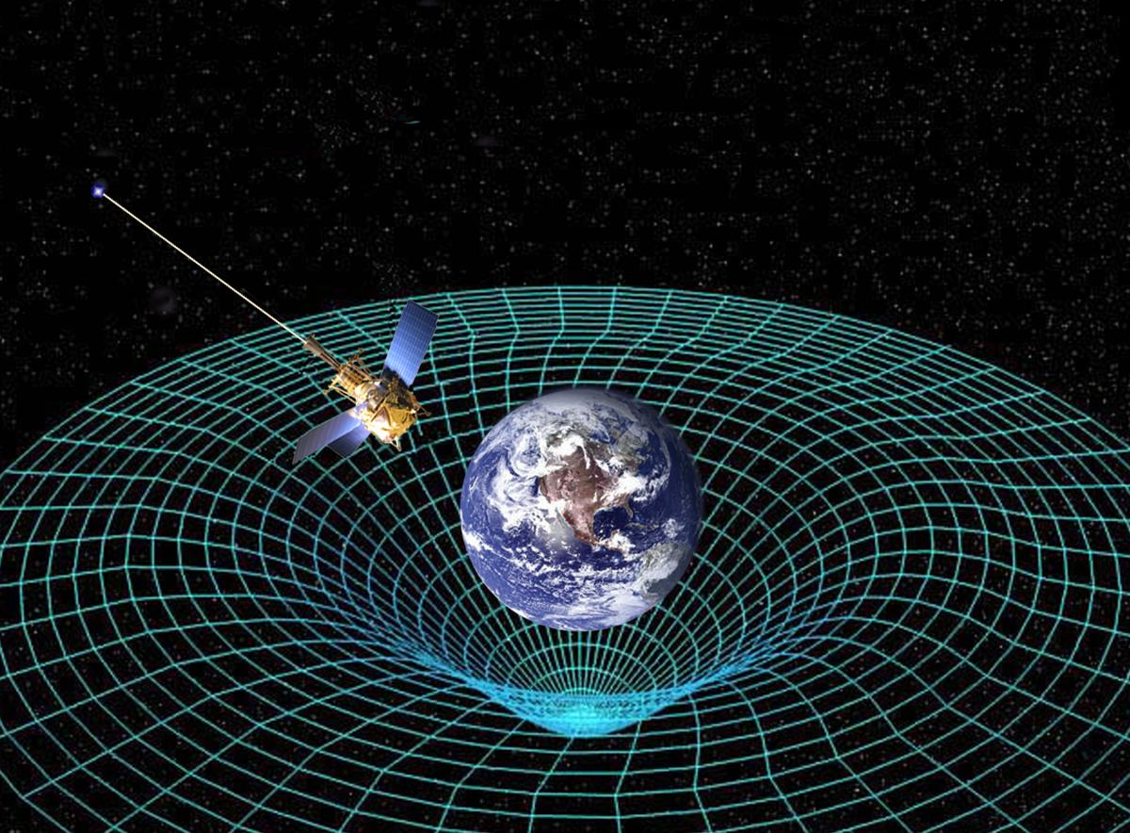
The Speed of Information
H₂O.ai
Factors to consider:
Speed of Light
3x10⁸ m/s
Infrastructure
Line-of-sight relays
Submarine Cables
Where is the information coming from?
Where is it going?
Lossless?
Power Consumption
Efficiency
Amount of Information
Bandwidth considerations (impacts infrastructure)
How quickly can you schlepp around 1TB? 1PB?
How quickly do you _need_ to do that?
I.e., are you making efficient use of resources?

Slide 5
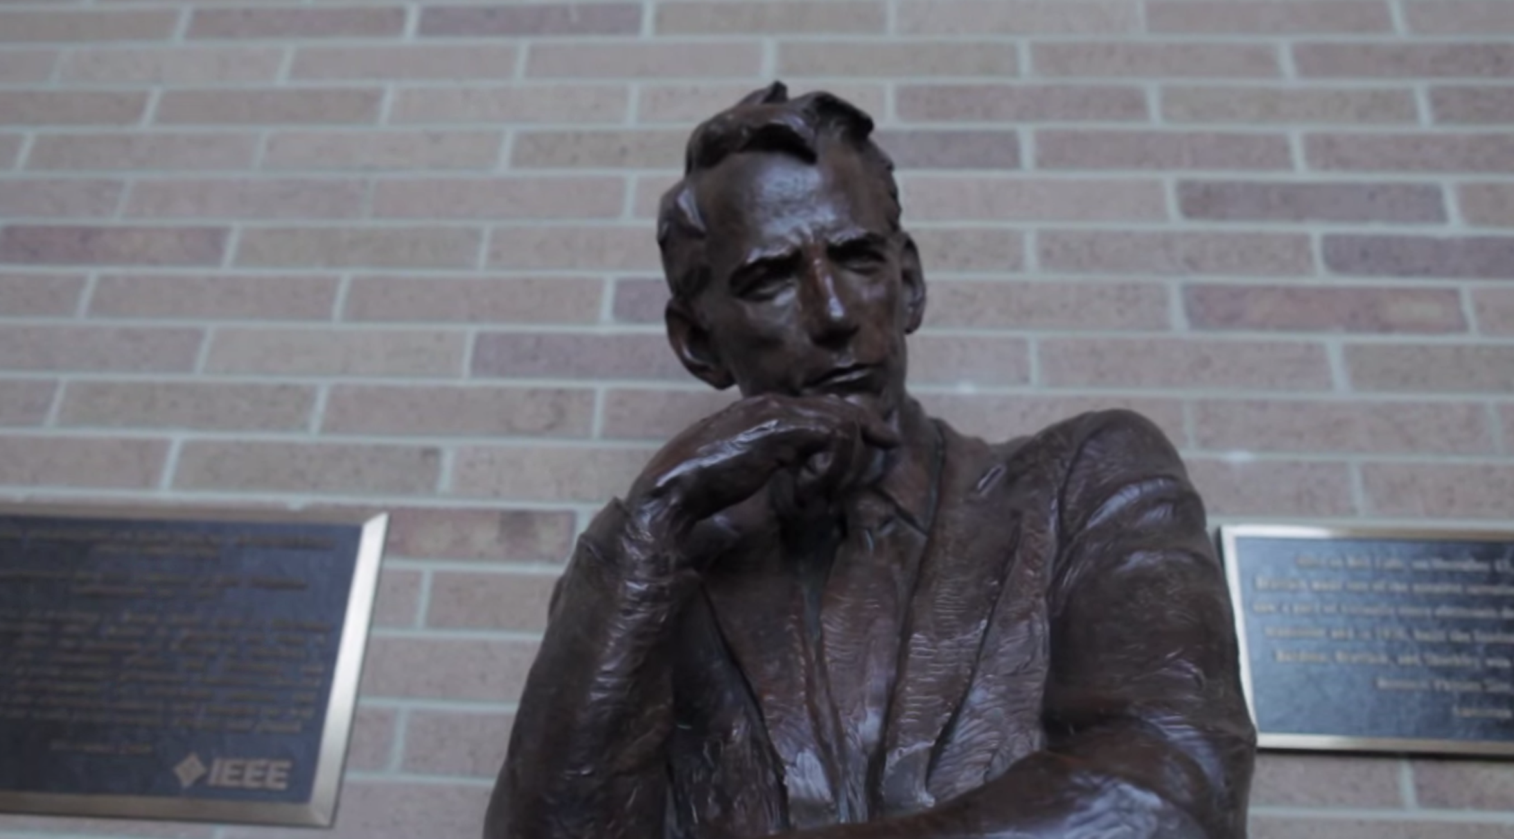
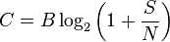
The Speed of Information
H₂O.ai
The Shannon Limit:
Sup({ Bounds on bits/s })
- C = Channel Capacity (bits/s)
- B = Bandwidth (Hz)
- S = Signal in Joules/s (Watts)
- N = Noise in Joules/s (Watts)

Slide 6
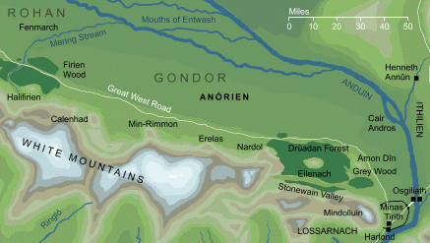

The Speed of Information
H₂O.ai
Consider: The Warning Beacons of Gondor
7 beacons (13 in the movie)
Probably 1 cord of wood (~3.6 m³)
1 bit of information (@ Shannon Limit)
optical transmission
Compare to the current World Record:
1 Petabit / second Fiber Transmission over 50-km
(~5,000 HDTV Videos/Second over single fiber)
About 25 orders of magnitude difference!
(source: http://www.ntt.co.jp/news2012/1209e/120920a.html)

Slide 7
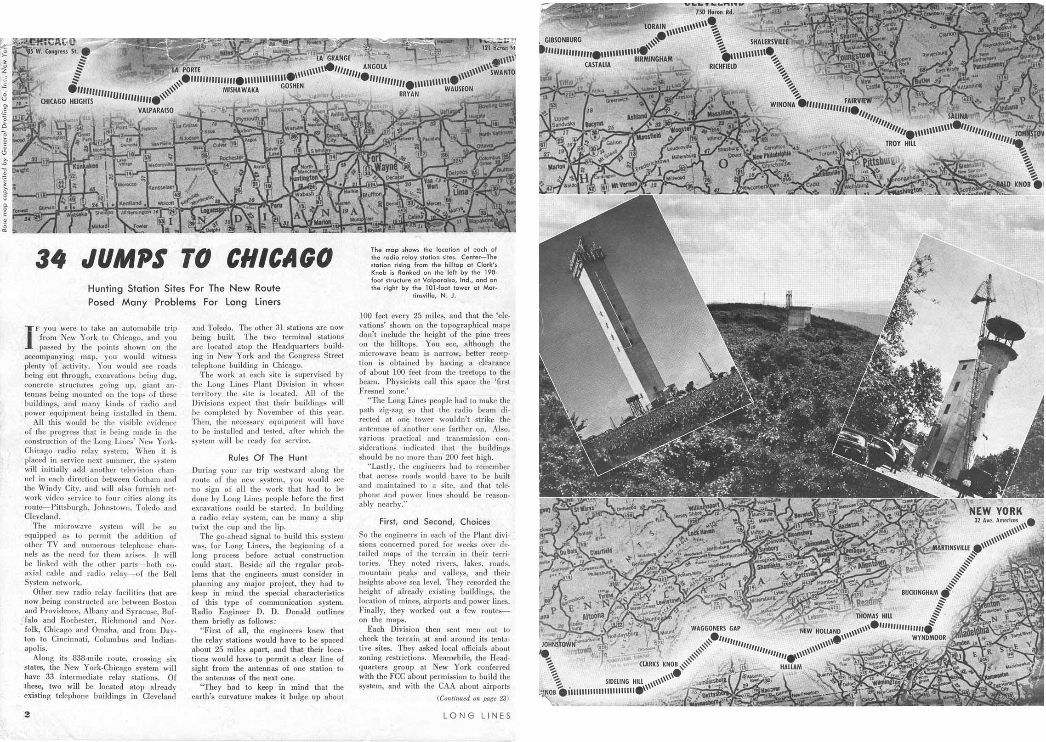
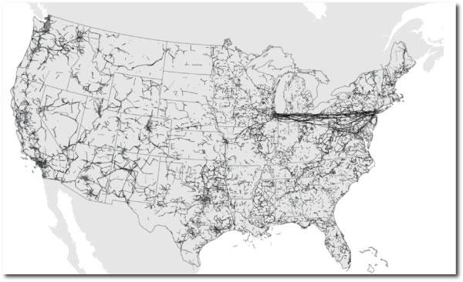
The Speed of Information
H₂O.ai
AT&T “Long Lines”:
838 mile route connecting Chicago to New York
4GHz microwave line-of-sight radio relays
~25 miles separation (due to curvature of the Earth)
34 hops in all
High Frequency Trading (HFT):
Light propagation delays between distant points are relevant
sources:
- Relativistic Statistical Arbitrage (http://www.alexwg.org/publications/PhysRevE_82-056104.pdf)
- Information Transmission Between Financial Markets in Chicago and New York (http://arxiv.org/pdf/1302.5966v1.pdf)

Slide 8
The Speed of Information
H₂O.ai
Observations:
Moving bits around is a big deal!
∃ insurmountable physical and theoretical limitations
Shannon Limit
Speed of Light
Landauer’s Principle
Relativistic Effects
Curvature of the Earth
Other limitations or complications?
Hairpinning: Non-optimal routing to far flung nodes
Geographic locality ≠ Internet locality
Bad hardware
Bad software

Slide 9
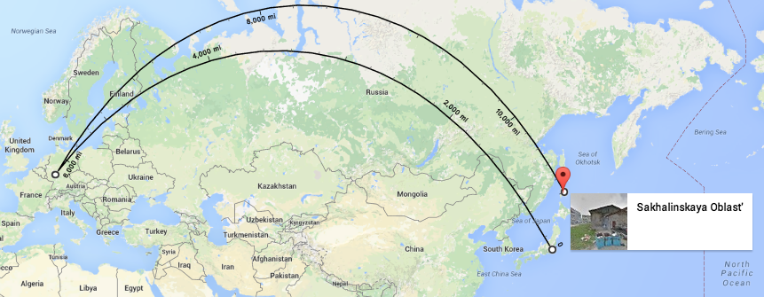
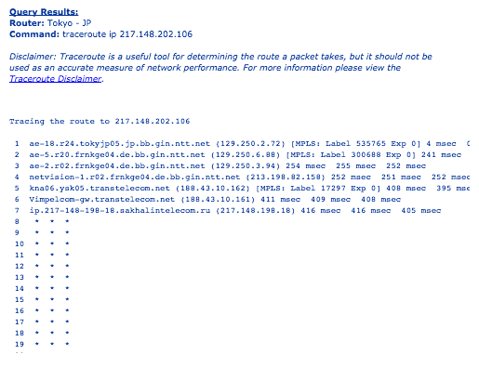
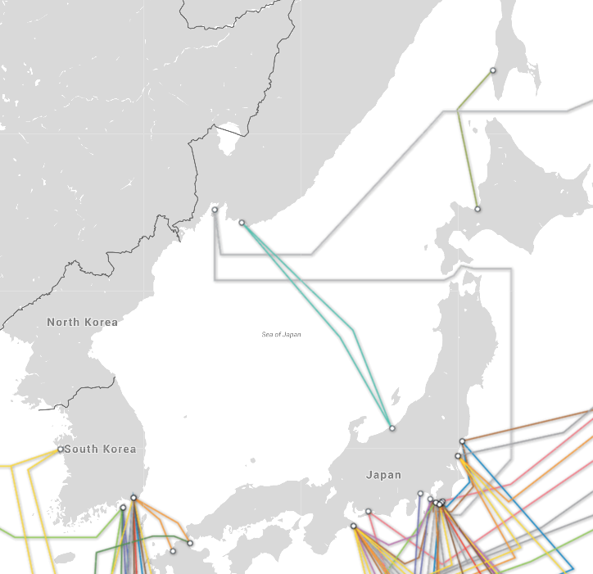
The Speed of Information
H₂O.ai
(n.d.). Retrieved from http://www.us.ntt.net/support/looking-glass/
(n.d.). Retrieved from http://www.submarinecablemap.com/

Slide 10
The Analytics Workflow
H₂O.ai
The Analytics Process:
Define your problem
Gather data and explore
Prepare your data for modeling
Modeling
Model Validation
Implementation & Tracking

Slide 11
The Analytics Workflow
H₂O.ai
The Analytics Process:
Define your problem
Gather data and explore
Prepare your data for modeling
Modeling
Model Validation
Implementation & Tracking
}
Here’s where H2O fits into the analytics process
http://learn.h2o.ai/content/

Slide 12

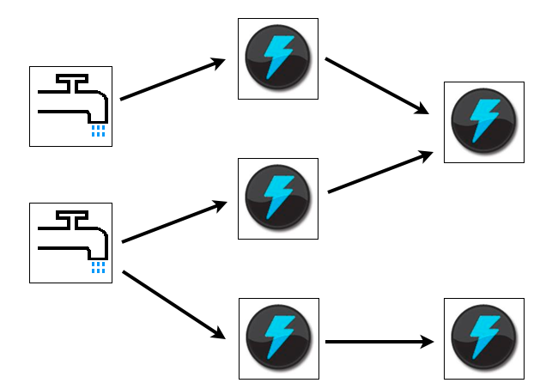
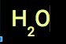
The Analytics Workflow
H₂O.ai
:::Prep:::
Data Preparation:
A sequence of transformations applied to your data
This step will define your Storm topology
Take raw information and give it structure

Slide 13

The Analytics Workflow
H₂O.ai
:::Modeling:::
Questions to ask yourself:
How fast must a scoring engine classify incoming tuples?
How do I optimize between scoring latency and predictive power?
E.g.What are the trade-offs between a GLM and a GBM?
Science!

Slide 14
The Analytics Workflow
H₂O.ai
:::Validation:::
Types of Validation:
N-fold cross validation
Train/Validate/Test -- What Features are Important?
Model Comparison -- Does your model optimize all needs?
Business needs
Resource needs
Repeat steps 3 - 5 until satisfied

Slide 15
The Analytics Workflow
H₂O.ai
:::Validation:::
Types of Validation:
N-fold cross validation
Train/Validate/Test -- What Features are Important?
Model Comparison -- Does your model optimize all needs?
Business needs
Resource needs
Repeat steps 3 - 5 until satisfied
WRONG: You should never be satisfied!
Your model will go out of date (if it hasn’t already)!

Slide 16
The Analytics Workflow
H₂O.ai
:::Tracking:::
An Extension of Validation:
Do not open the fire-hose and blast your model with 100% of your data
Expect the unexpected
Your topology might will break (oops forgot about unicode… derp)
Start off with 10% and ramp up; course-correct along the way
Perform batch modeling in off-peak hours (Jenkins never sleeps)
Models should be replaced “gradually”

Slide 17
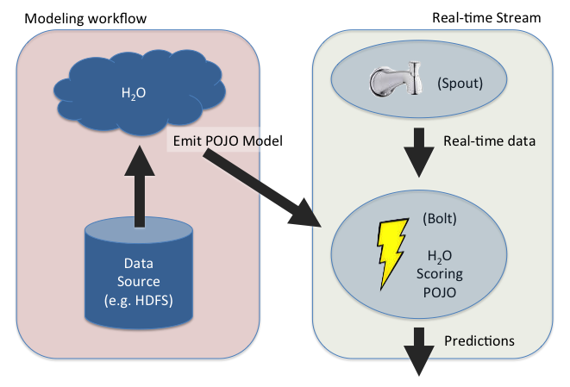
H2O // Storm
H₂O.ai

Slide 18
H2O // Storm
H₂O.ai
For a complete tutorial please visit:
http://learn.h2o.ai/content/demos/streaming_data.html

Slide 19

H₂O.ai
Use H2O
Awesome

Slide 20
H₂O.ai
Thank you!

Slide 21
H₂O.ai
DEMO
http://learn.h2o.ai/content/demos/streaming_data.html

